Slide 1
KP Overview
Version 6.1

Slide 2

Table of contents
Objectives
Abbreviations

Slide 3
Objectives
The purpose of this presentation is to enable trainees understand:
List of parts contained in a fully assembled KOKOPoint(KP)
The basic functions of a KOKOpoint

Slide 4
Abbreviations
KP - KOKOpoint
KPC - KOKOpoint controller
SMV- Smart Valve
QC - Quality Control
Vxx - version number
MBV - motorized ball valve
PCB - Printed circuit board
NFC - Near field communication

Slide 5
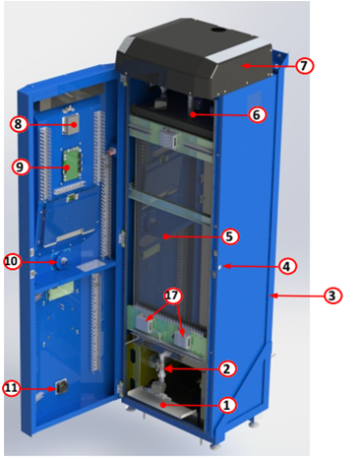
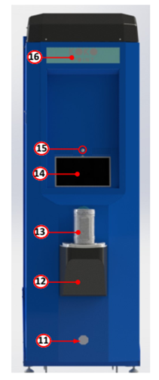
KP parts overview
1. Sump
2. Dispense column
3. L-Frame
4. Door lock
5. Tank
6. Refilling valves
7. Hood
8. Calibration unit
9. KP Controller
10. Canister Full Sensor
11. Ventilation fan
12. Canister dock
13. Canister
14. Screen
15. Motion sensor
16. KOKO sign
17. Emergency Switch

Slide 6
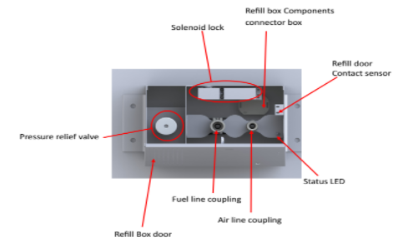
Refill box
Allows you to refill the KP with fuel
It is connected to the KP via refill hoses and refill cables

Slide 7
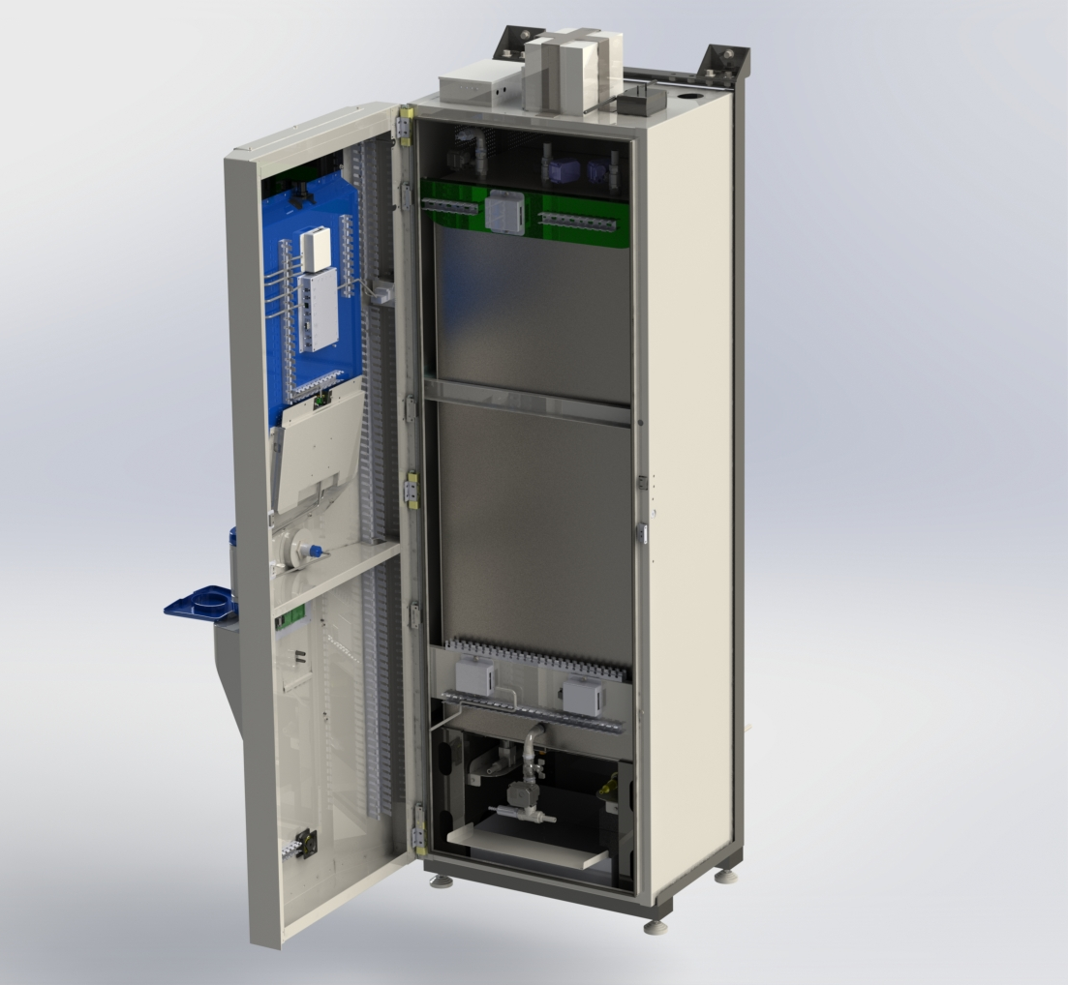
KP parts overview cont.

Slide 8
List of components
SENSORS & SWITCHES
Flowmeter(FLM)
NFC board
Tank level sensor(TPS)
Canister full sensor(CF)
Reed switch(KP door sensor & refill box door sensor)
PIR (motion sensor)
Dock limit switch(Canister dock switch)
Ethanol sensor
Temperature sensor
Reset switch
ACCESSIBILITY DEVICES
Tablet
Modem
Illumination module
POWER UNIT ACCESSORIES
UPS,
Battery
Emergency cut-off switch

Slide 9
List of components cont.
PCBs
KPC
Calibration module
Connector PCBs(Above tank,Below left and Below right,Refill box)
PLUMBING PARTS & FITTINGS
Smart Valve
Pressure release valve(in the refill box)
½” manual ball valve
½” 3-piece union
½” nipple
½” tee joint
barbed connector(tail end-½”,¾”)
elbow(½”,¾”)
hose clip(9mm,11mm,28mm)
½”-to-¼” reducing bush
cam lock connector couplings
8mm silicone hose(dispense fuel line)
6mm silicone hose(dispense air line)
ACTUATORS
Motorised ball valves
Microelectric Pump
Diaphragm Valve (Solenoid)
Door lock & latch(for both the KP and refill box)
Fan

Slide 10
List of components cont.
Cables
CAT 6 Ethernet cable
USB A-B cable
D-connector cable
AC/Mains cable

Slide 11

User Interface - Tablet
14” android device with 64GB internal storage.
An android application KOKO apk is installed to allow the customer to access his/her account,purchase stove s and purchase fuel.

Slide 12
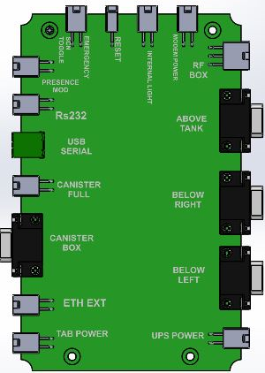
KPC
Custom built.
Can be referred as the heart of the KP
The firmware is uploaded to the embedded arduino board(Mega 2560) to manage the hardware components

Slide 13
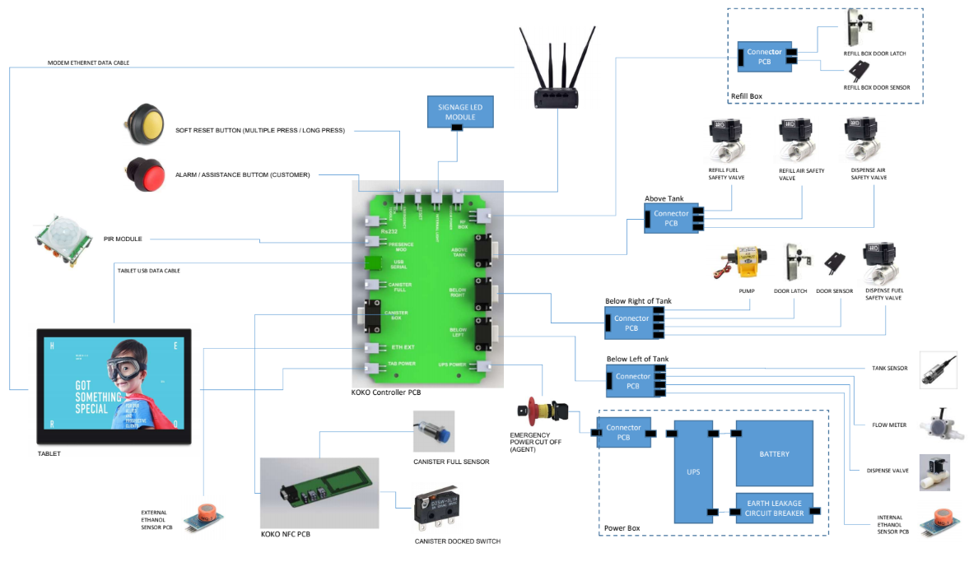
KPC cont.

Slide 14
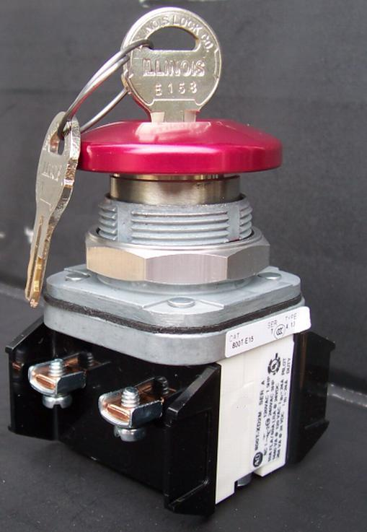
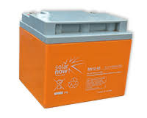
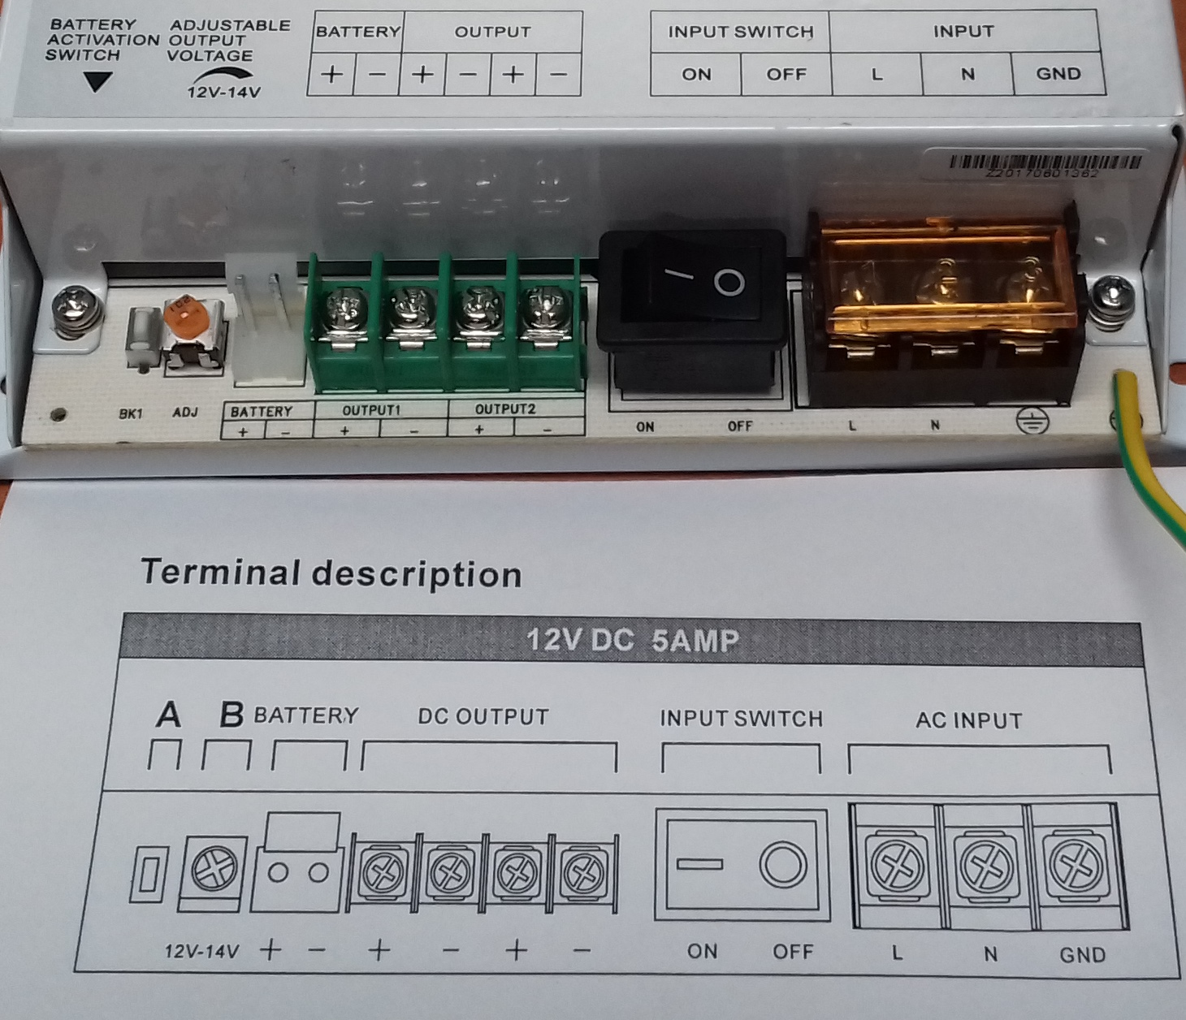
Power unit
The power unit of a KP consists of the UPS, 12V 40Ah Battery and an emergency cut off switch

Slide 15
Power unit cont.
AC(240V)
DC(12V)
Charging
Back Up
12V Battery

Slide 16
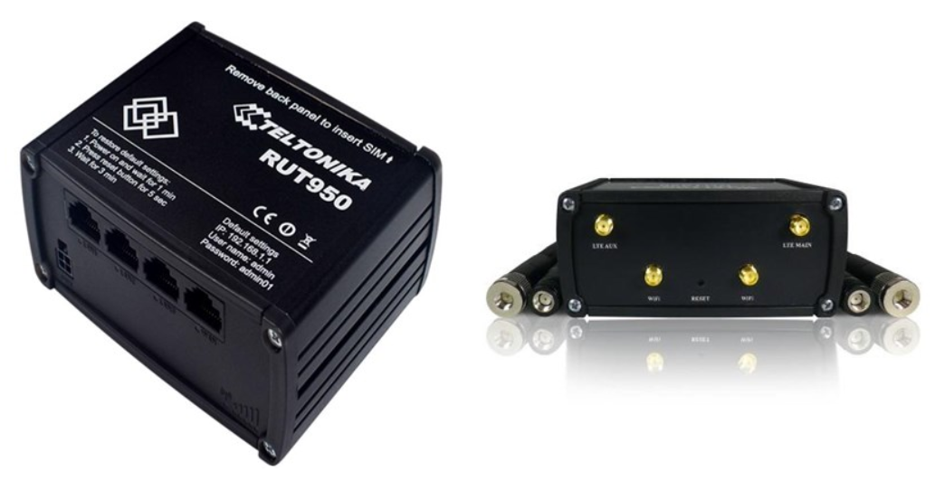
Modem
Teltonika modem - RUT950 LTE
The modem provided remote internet connectivity.
Service Providers: Safaricom (main service provider)
airtel Kenya (backup service provider).
It has two mobile antennae,a power cable and ethernet cable

Slide 17
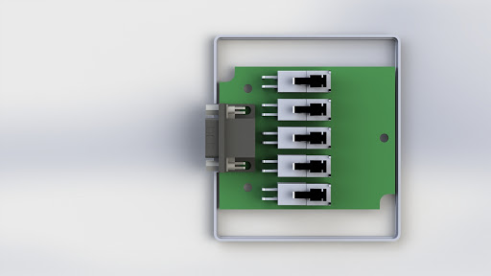
Connector PCBs
There are four PCB connectors above tank, below left, below right, and refill box
They connect the KPC to various components
Lead seal applied here
FLM
DV
TS
IE
TEMP
Below Left Connector PCB

Slide 18
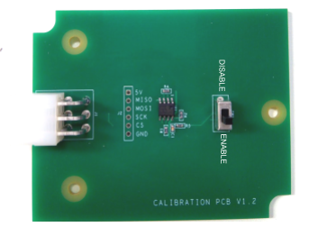
Calibration module
The calibration module is PCB that holds the metrologically relevant parameters used by the KPC to dispense fuel.
When connected the KPC is able to read these parameters. They can be updated if and only if the write enable switch is set to the enable position.
It is housed inside an enclosure with a wire and a lead seal to prevent unauthorised access to the write switch.

Slide 19
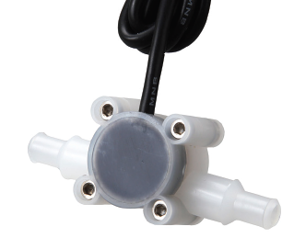
Flowmeter
The turbine flowmeter is the measuring unit of the KOKOpoint
Has a precision turbine that rotates freely generating pulses
Has a flow direction as demonstrated
A calibration exercise leads to selection of a K factor(FMK)

Slide 20
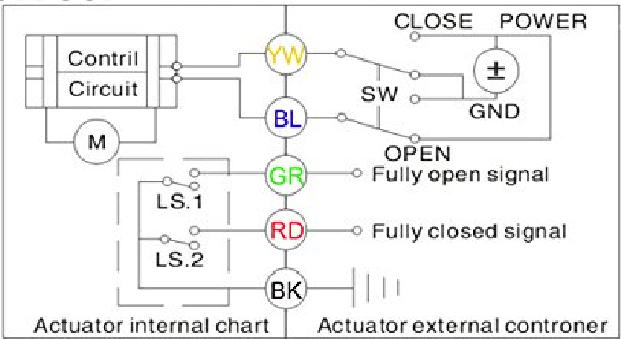
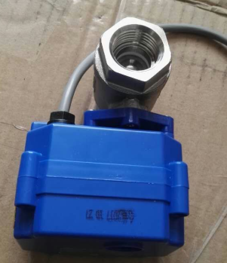
MBV
It is a motor driven actuator.
The valve opens to allow fuel flow or closes to end flow.
It uses two limit switches to indicate valve open/close status.

Slide 21
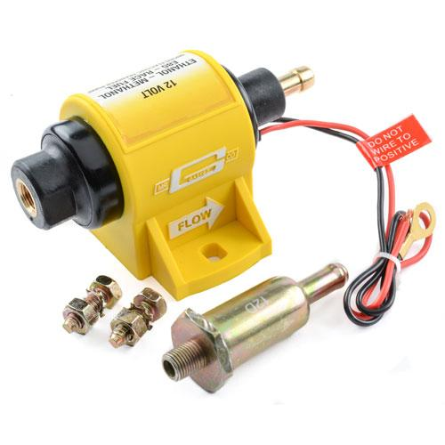
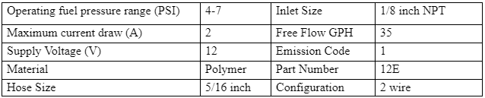
Pumping unit
This is an inline KP pump that provides a constant flow output to the flowmeter
Include 100 micron inline filter
It is directional as shown by arrow
Pump filter

Slide 22
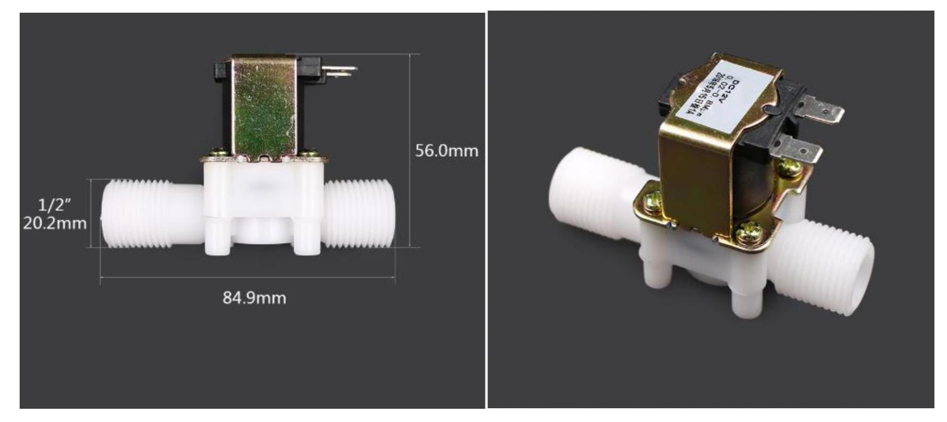
Dispense Valve
This a normally closed solenoid valve used for dispense precision during dispensing
It is one way valve(directional).

Slide 23
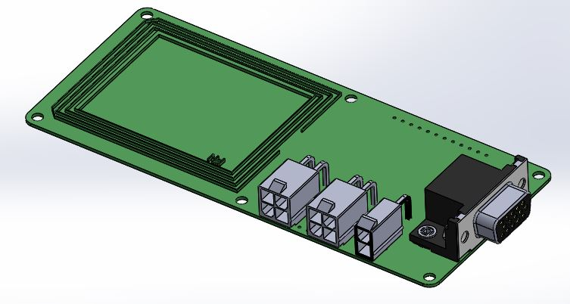
NFC PCB
NFC-Near field communication
NFC board reads the unique code on each canister for identification of customer

Slide 24
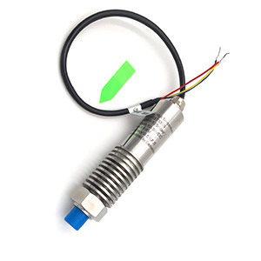
Tank level sensor
Level sensor indicates level of fuel in the tank
It is a 5V 130mbar analogue pressure sensor from Eastsensor

Slide 25
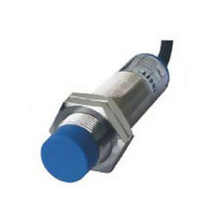
Canister full sensor
It is a capacitive sensor that prevents a canister from overfilling
Sensitive to ethanol in the canister at a range of 20mm
Has a sensitivity adjustment potentiometer

Slide 26
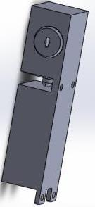
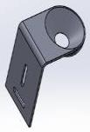
Door lock and latch
The electro-mechanical lock that enables both electronic access via the maintenance interface or mechanically using keys
Also present in the refill box
Lock
Latch

Slide 27
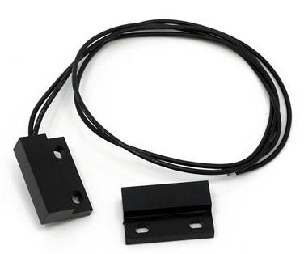
Door sensor and actuator
It is an electromagnetic switch that used to indicate when a KP door is opened or closed
Also present in the refill box

Slide 28
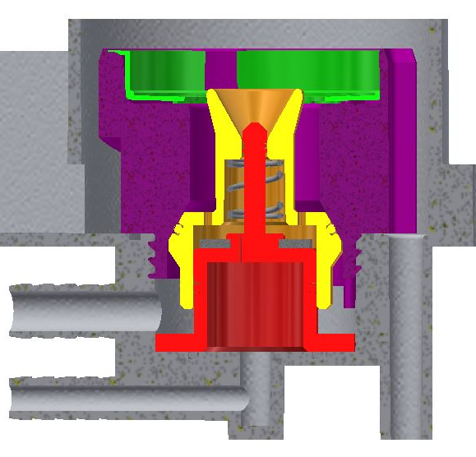
Smart Valve
This a custom made valve designed by KOKO
This is the canister docking point to enable a customer to purchase fuel
Contains a number of o-rings

Slide 29
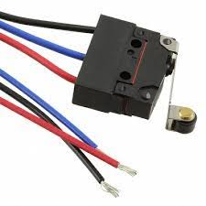
Canister dock switch
The limit switch is the first check before a docked canister can be read and triggers the termination of a dispense when canister undocked

Slide 30
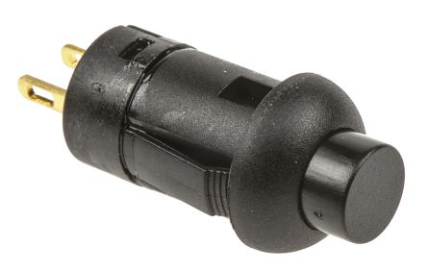
Reset switch
The reset switch is used to powercycle the modem and tablet when pressed.
This is based on the KPC firmware

Slide 31
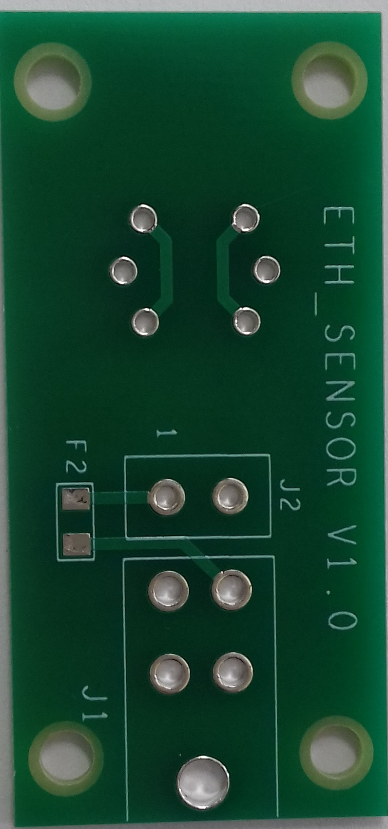
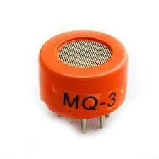
Ethanol sensor
The ethanol sensor (MQ3) is used to detect ethanol vapour concentration in the KP.
This informs when a KP is leaking

Slide 32
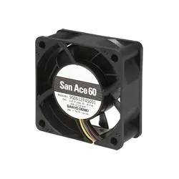
Fan
The fan is constantly on to exhaust ethanol vapour around the dispense column and tray.
This is a safety measure to reduce risk of ignition.

Slide 33
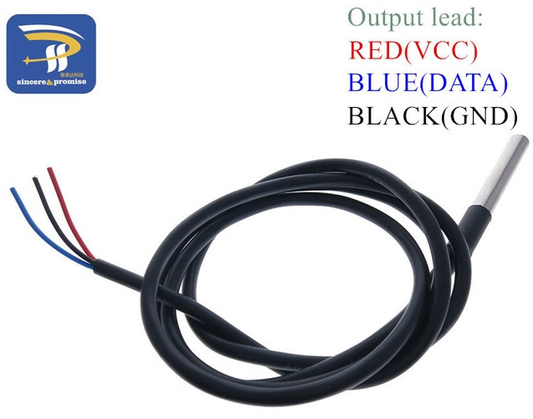
Tank temperature sensor
The 5V powered tank temperature sensor is stuck on the left bottom side of the tank
Used to monitor fuel temperatures via the wall of the tank.

Slide 34
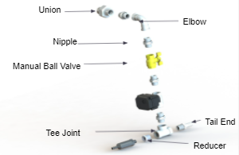
Dispense column
The KP has various SS mechanical fittings
The main purpose of the dispense column is to hold various important components to the tank
Manual ball valve is used to isolate the tank during maintenance of other faulty components/fittings

Slide 35
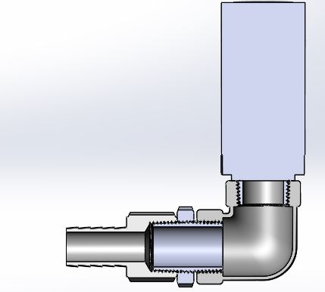
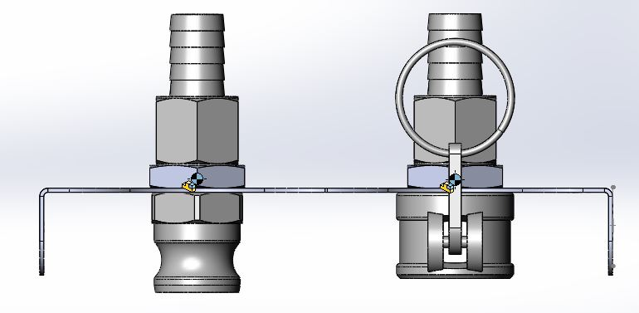
Pressure Vacuum Release Valve,PVRV and Camlock
PVRV is a safety valve that controls tank ethanol vapour pressure per set safety threshold
Is fitted in the refill box
The refill box consists of cam locks as shown (left picture) one for refill fuel and refill air

Slide 36
KP dispense process
When a customer docks a canister, NFC reader detects and reads the canister ID.
Through the tablet the customer logs into the system to buy fuel.
Communication with the server occurs via APIs when and the customer PIN requested.
Customer logs in and his/her account details are displayed.
Customer is able to buy fuel.
Customer logs out/exit and undocks the canister.
A KOKO maintenance technician is also able to perform various maintenance tasks via the maintenance interface

